Slide 1
The Four Humours: And it isn’t funny.
What are the four humours and what have these to do with medicine?

Slide 2
Can you match these up?
Make an educated guess about what the illness will do next, with or without treatment.
Diagnosis
If necessary, give them medicines or advice on how to combat the illness or the disease.
Prognosis
Look at the symptoms of the disease and decide what the disease or condition is.
Observation
Treatment
Look and record the progress of illness, making notes of the signs and symptoms of the disease.

Slide 3
What are we looking at today?
Who created the Four Humours?
1-3: Describe the main influences of Hippocrates in medicine today, understand how the way the four humours worked.
4-6: Explain and analyse some of the main influences on medicine today.
7-9: Analyse a range of reasons why Hippocrates is so important and influential today.
What are the four humours and what have these to do with medicine?
Why did the Greeks believe in the four humours?
How much influence does Hippocrates have on todays medical care?
If Hippocrates is still important today, does this help explain why he was much more important in the middle ages?
What are the limitations of the four humours?
Literacy focus:
Writing in note form.
Helping assess others work.
Key words and correct use.

Slide 4



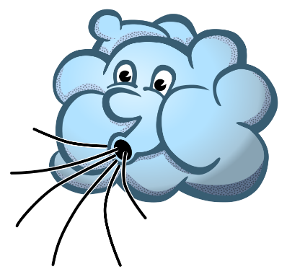




The ancient Greeks.
The Greeks had a massive empire before the Romans.
The Greeks liked to look at the world in a logical way. They said that there were 4 elements that matched the 4 seasons. They worked out a theory that if these were not in balance then chaos would ensue!
Air
Fire
Earth
Water

Slide 5
So what did Hippocrates do?
He was a doctor who lived in on the Greek island of Kos around 2,500 years ago.
Hippocrates worked out that there had to be four liquids in the human body and if they were all in balance, then the person was well. However, these liquids could become out of balance because of the seasons and elements. It made perfect sense.
It was, however, utterly wrong, but there was no way to prove or disprove it.

Slide 6
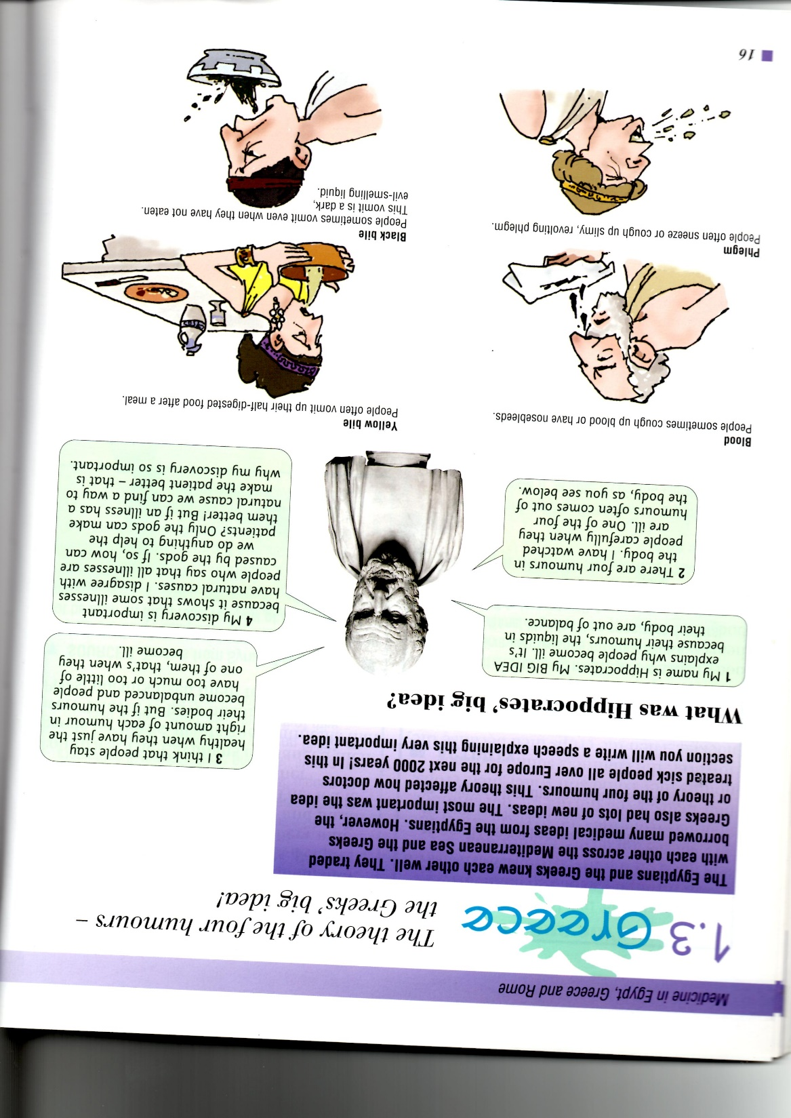
Images taken from page 16, “Medicine through Time” foundation edition, Stanley Thornes.

Slide 7


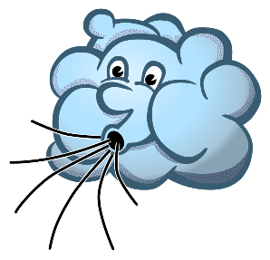




Earth
Water
Air
Fire
Black Bile
Phlegm
Blood
Yellow Bile
What are the four humours and what have these to do with medicine?
Why did the Greeks believe in the four humours?
What are the limitations of the four humours?

Slide 8
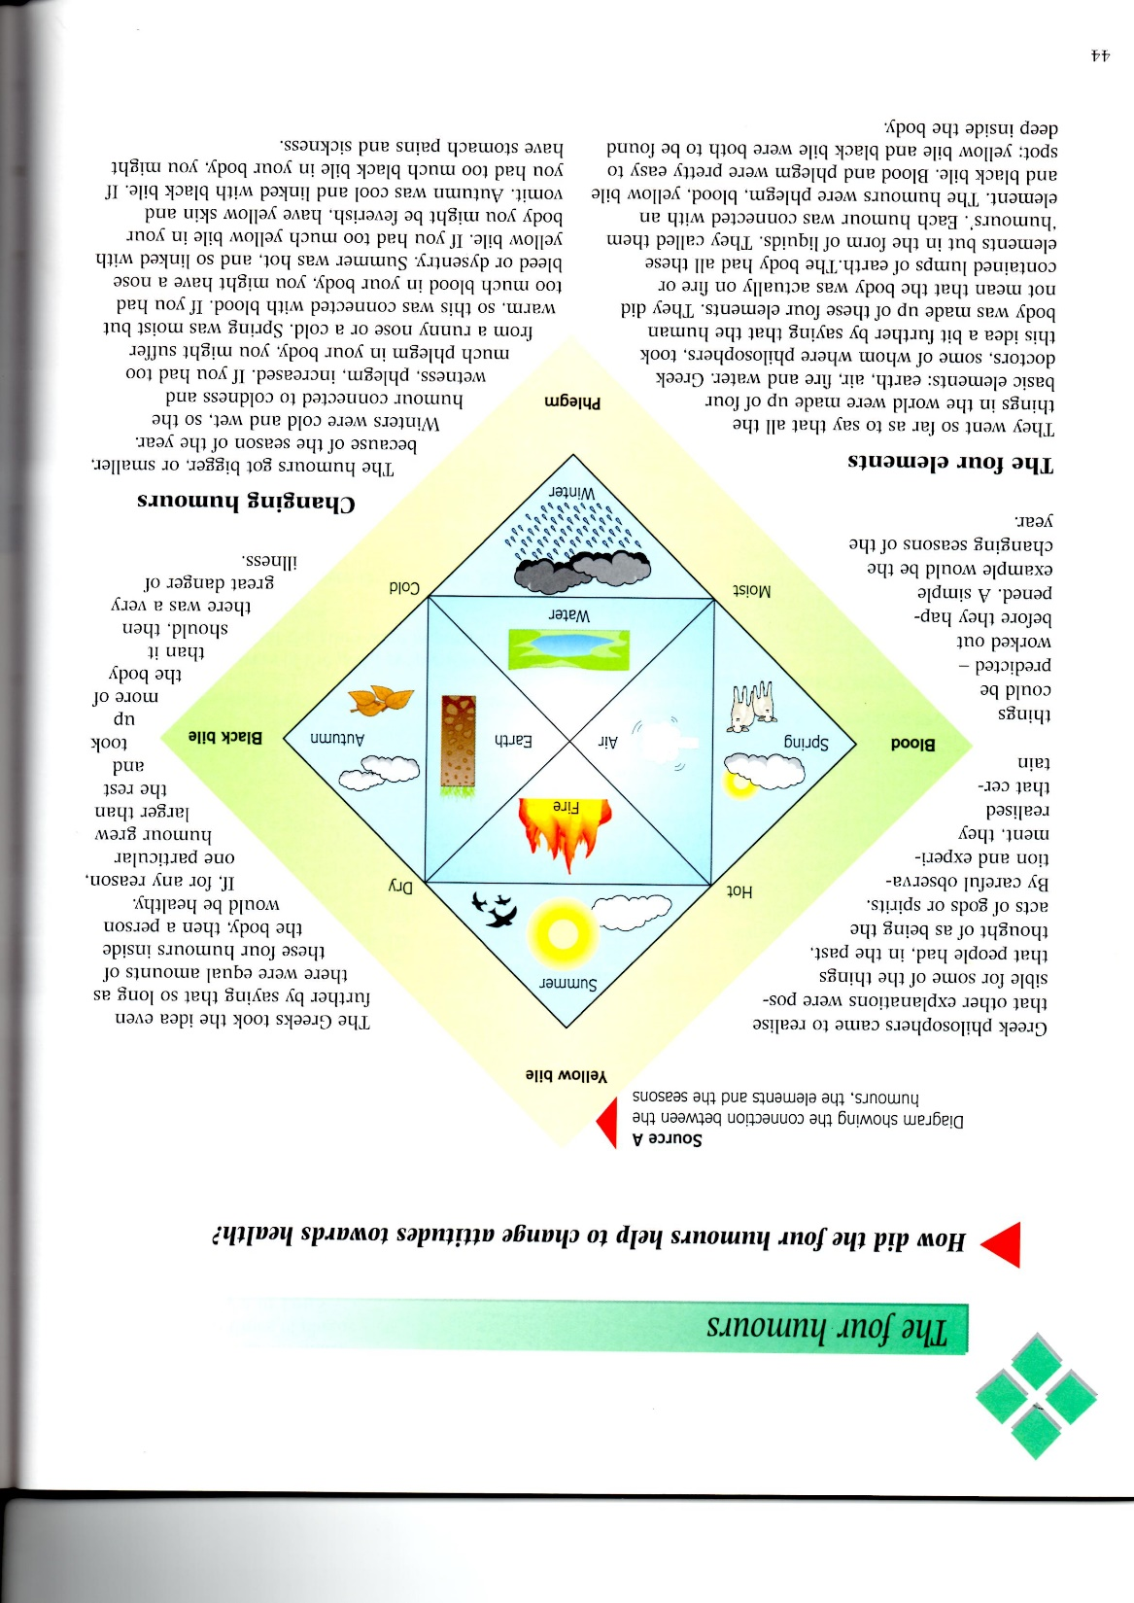
1-3: Describe the main influences of Hippocrates in medicine today, understand how the way the four humours worked.
Make a copy of this diagram in your books. This is how the Four Humours are shown.

Slide 9
Once you have read this, you should look at the chart. You will be given a chart to fill in. I have done some of the answers for some of you.
You will have 15 minutes to complete this.
Swap with the person next to you. In green pen/pencil, write in any ideas that your shoulder partner has missed.
You have 5 minutes to add your ideas.
Hand back the work.
Is there anything else you want to add to your chart?
1-3: Describe the main influences of Hippocrates in medicine today, understand how the way the four humours worked.
4-6: Explain and analyse some of the main influences on medicine today.
7-9: Analyse a range of reasons why Hippocrates is so important and influential today.
How much influence does Hippocrates have on todays medical care?
If Hippocrates is still important today, does this help explain why he was much more important in the middle ages?

Slide 10
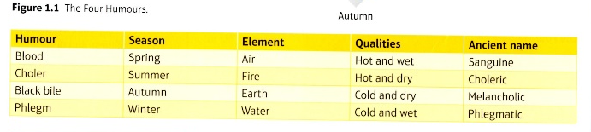
By the Medieval Period….
Taken from the Pearson GCSE 1-9, by S Thorne and H Stark. Page 16.
This is how the four humours were used by the doctors. The Ancient name is interesting as we now use these to describe people! A Choleric person is a person thought to have a fiery temper! A melancholic person is said to be sad and depressed, so having an excess of black bile. An optimistic and calm person who saw the best would be described as a sanguine person. By 1250 people were using these words to describe a person, believing that the four humours influenced the personality of the person!
But they also said that the 12 houses of the Zodiac were distributed to the four humours! So these star signs could influence the humour and it’s imbalance within the human body!

Slide 11
Finally:
What do you think is the most important contribution to medicine that Hippocrates made?

Slide 12
Homework:
Find out about Claudius Galen.
He was a Greek doctor living in the Roman Empire.
Extra points if you can find out his connection to the film “Gladiator”.

Slide 14
 | Same as today | Different to today
Belief in Gods being only for good.
Clinical observation and making detailed notes.
Use of the 4 humours as the cause of disease.
Use of surgery and people who do the surgery.
Use of medicines for treatment.
Staying healthy.
Training of doctors.
Being confidential and trusted by the patient.

Slide 15
 | Same as today | Different to today
Belief in Gods being only for good.
Clinical observation and making detailed notes. |  | Drs and nurses store note on: Who employs your doctor:
Use of the 4 humours as the cause of disease. | We do not use this today.
Use of surgery and people who do the surgery. | We still complete the same types of operations as the Greeks. | What else do the surgeons of today do? Who completes the surgery?
Use of medicines for treatment.
Staying healthy.
Training of doctors.
Being confidential and trusted by the patient.

Slide 16
 | Same as today | Different to today
Belief in Gods being only for good.
Clinical observation and making detailed notes. |  | Each patient should have detailed notes for each visit, on a central computer system. These are stored by the NHS who employ the doctor and nurses.
Use of the 4 humours as the cause of disease. | We don’t use this belief any more.
Use of surgery and people who do the surgery. | Surgery today also includes the surgery completed then. | Drs are trained in surgery and then can specialise in different types of surgery at a hospital. Surgery can be very effective due to better technology and understanding.
Use of medicines for treatment.
Staying healthy.
Training of doctors.
Being confidential and trusted by the patient.

